Slide 1
LungMAP Presentation #1
Pablo Ortiz, Vivek Sriram, and Lina Yang
Faculty Advisors: Dr. Cliburn Chan and Dr. Megan Neely
PhD Advisor: Robert Ravier
Notes:
Vivek

Slide 2

Roadmap
Context
Tools
Progress
Notes:
Vivek

Slide 3

The LungMAP project
A web-based atlas consisting of various forms of pulmonary data from research centers across the country
Notes:
Vivek

Slide 4
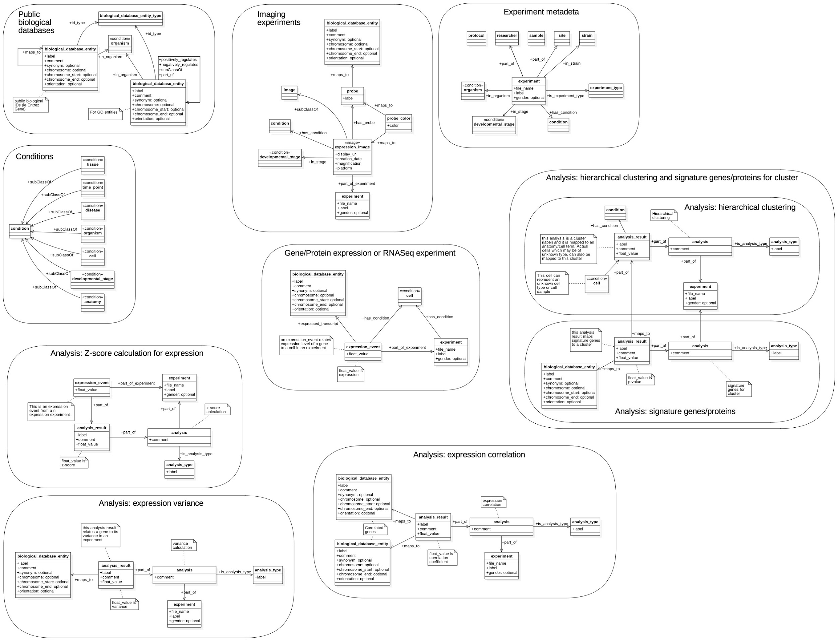
Public biological databases
Gene/Protein expression
RNASeq
Cell categorization/clustering
Imaging experiments
Experiment metadata
http://www.lungmap.net
Notes:
Vivek

Slide 5
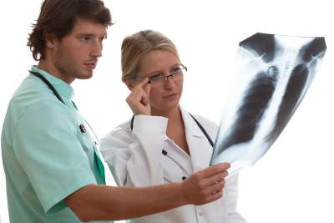
Purpose
Develop a statistical learning pipeline to classify immunofluorescent images of developing lungs
Create a useful database of annotated lung images to support investigations into the processes that regulate lung development
Notes:
Lina

Slide 6
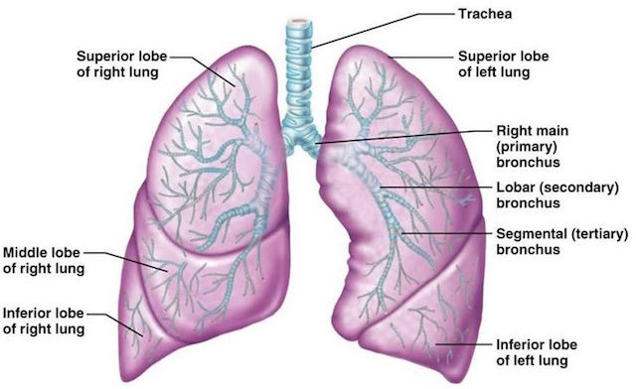
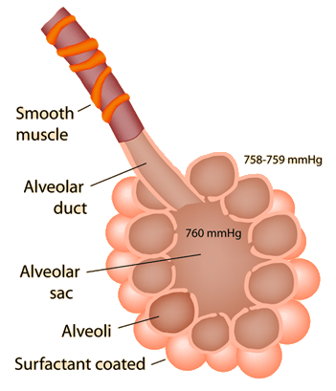
Basics of Lung Anatomy
Notes:
Lina

Slide 7
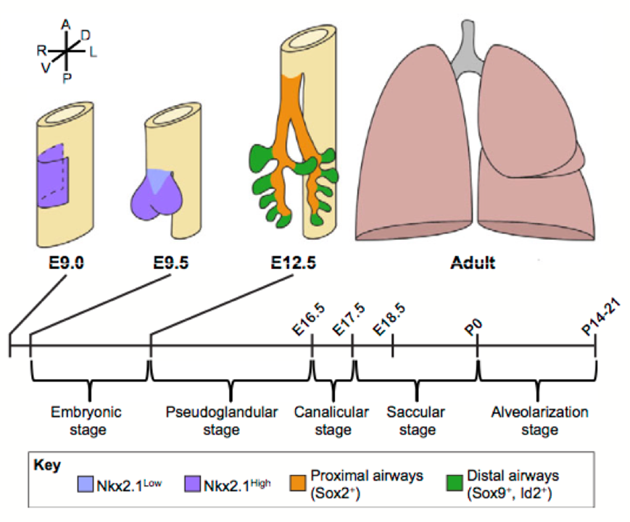
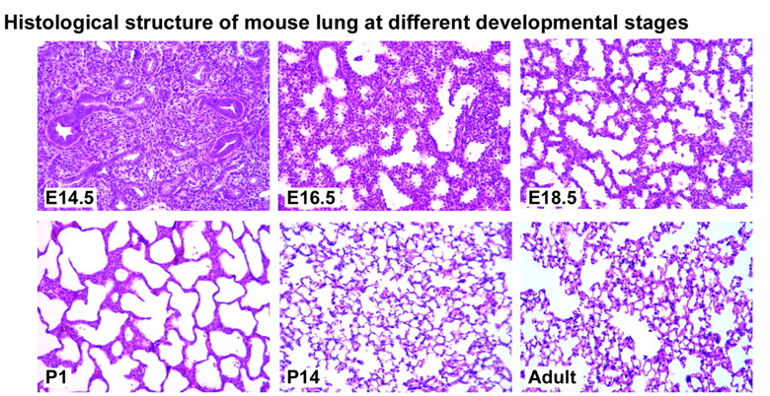
Lung Development
Herriges, Michael, and Edward E. Morrisey. "Lung development: orchestrating the generation and regeneration of a complex organ."Development 141.3 (2014): 502-513.
Notes:
Lina

Slide 8
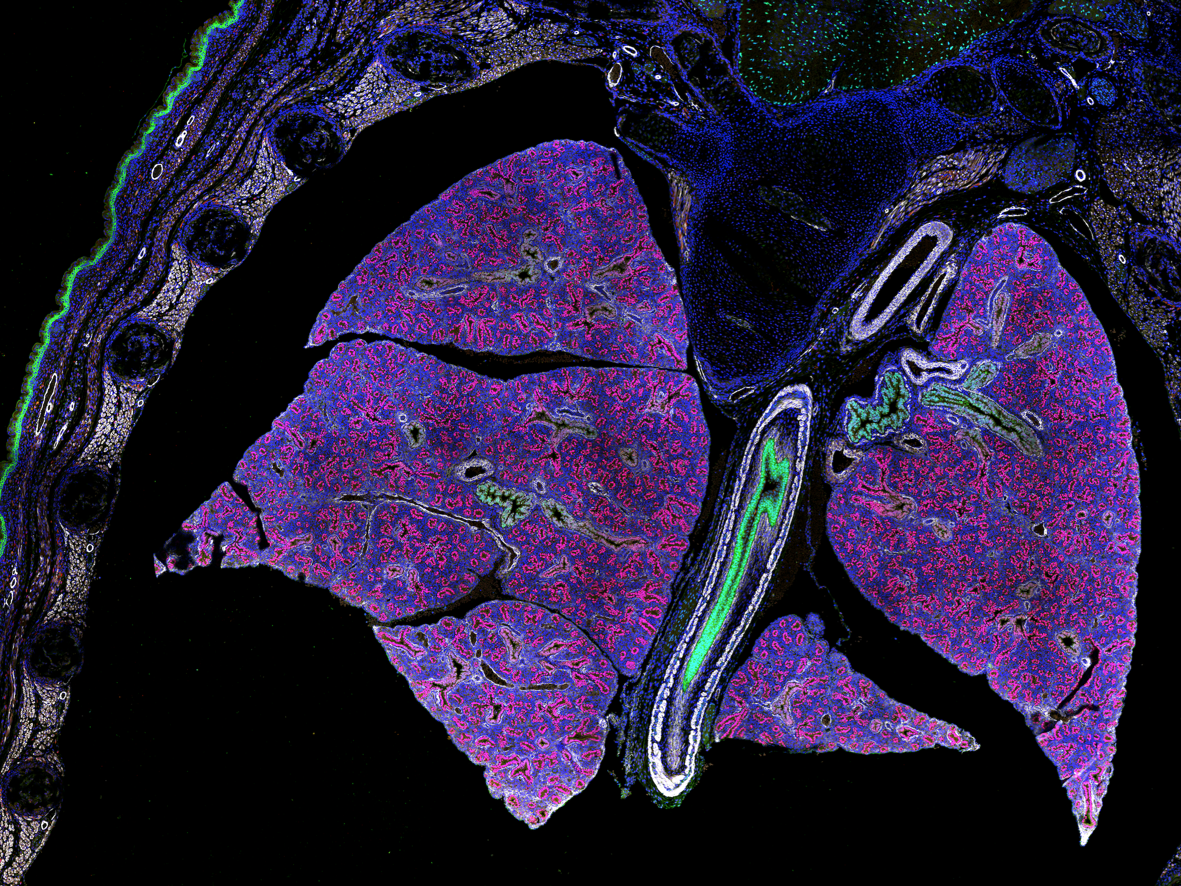
Initial Explorations
Green: Sox2 (a TF needed for self-replication of undifferentiated stem cells) - marks tracheal/bronchial epithelial cells
Red: TTF-1 (regulates gene transcription in thyroid and lungs) - marks a variety of cells intrinsic to lungs, including precursors to alveoli, ciliated cells, club cells that secrete protective proteins, and pneumocytes
White: Acta2 - marks smooth muscle, myofibroblasts, and pericytes
Blue: Mesenchyme - loosely organized embryonic tissue that turns into connective tissue, including blood/lymph
Notes:
Vivek

Slide 9







Tools
Fiji
Notes:
Pablo

Slide 10
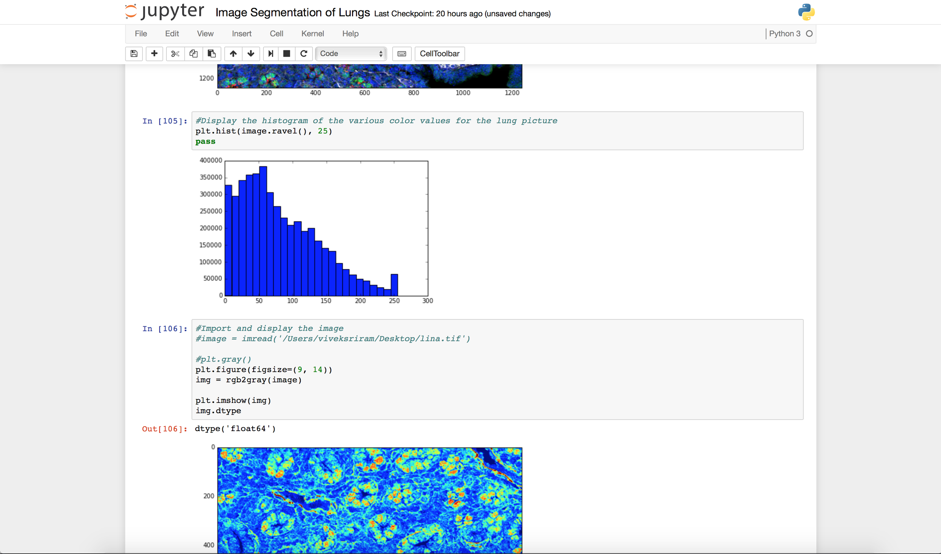
Tools Cont.
Notes:
Pablo

Slide 11
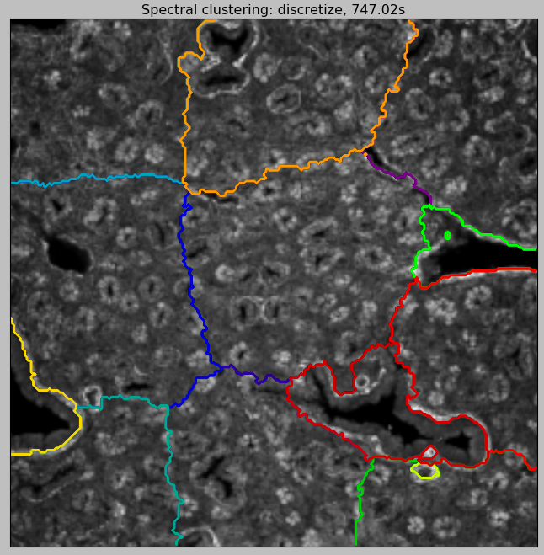
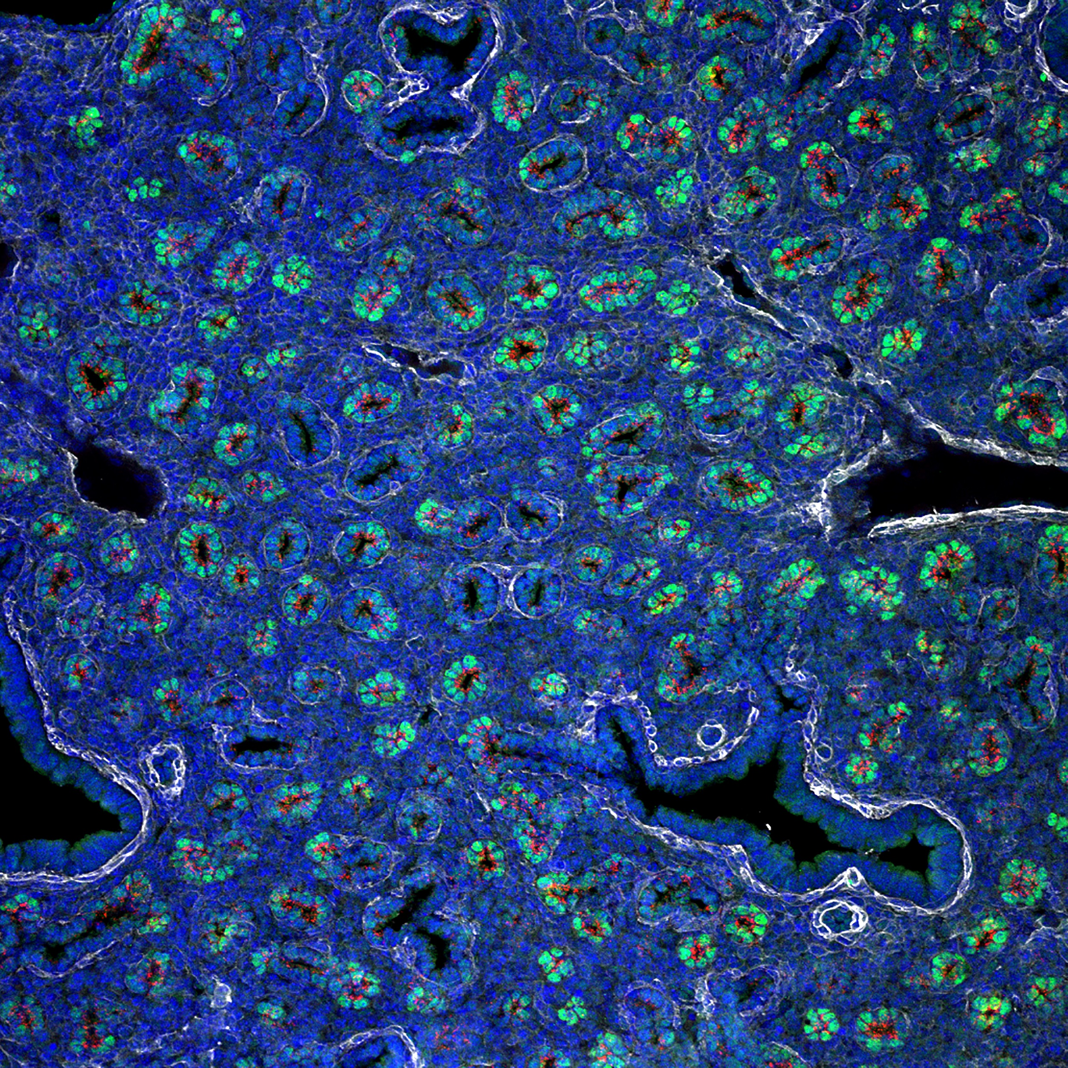
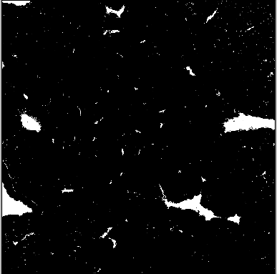
Progress - Grayscale

Slide 12
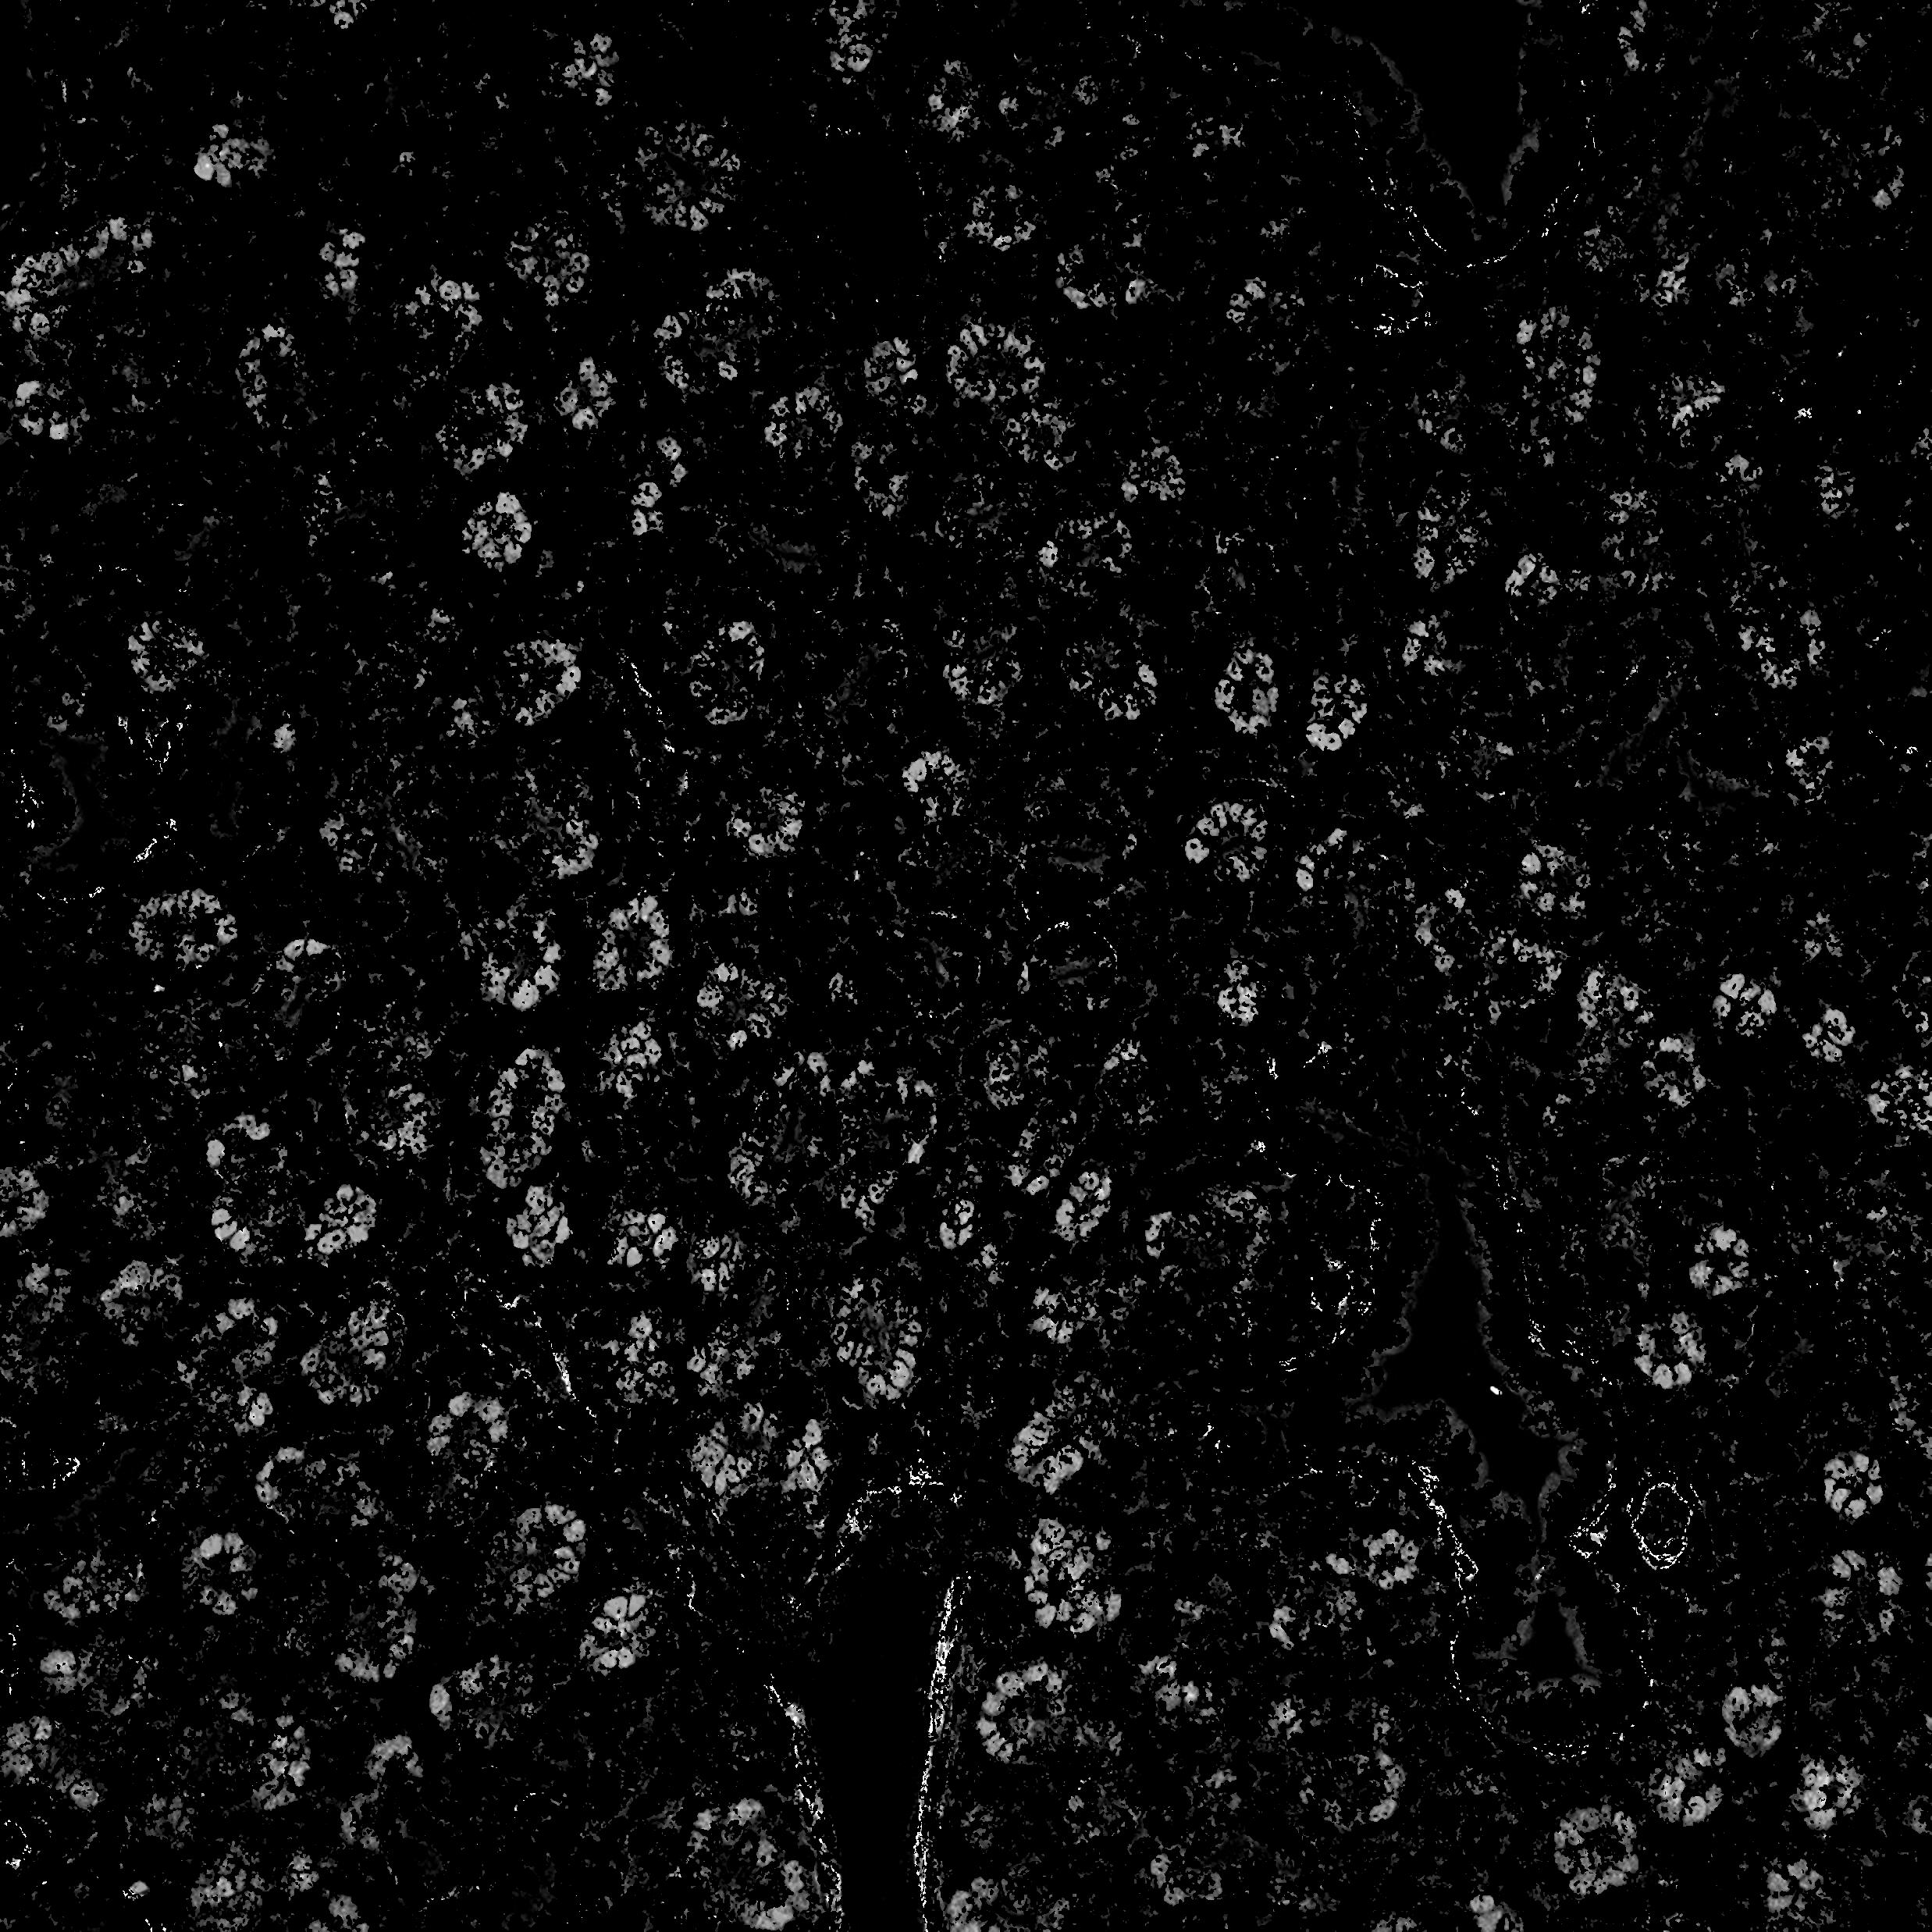
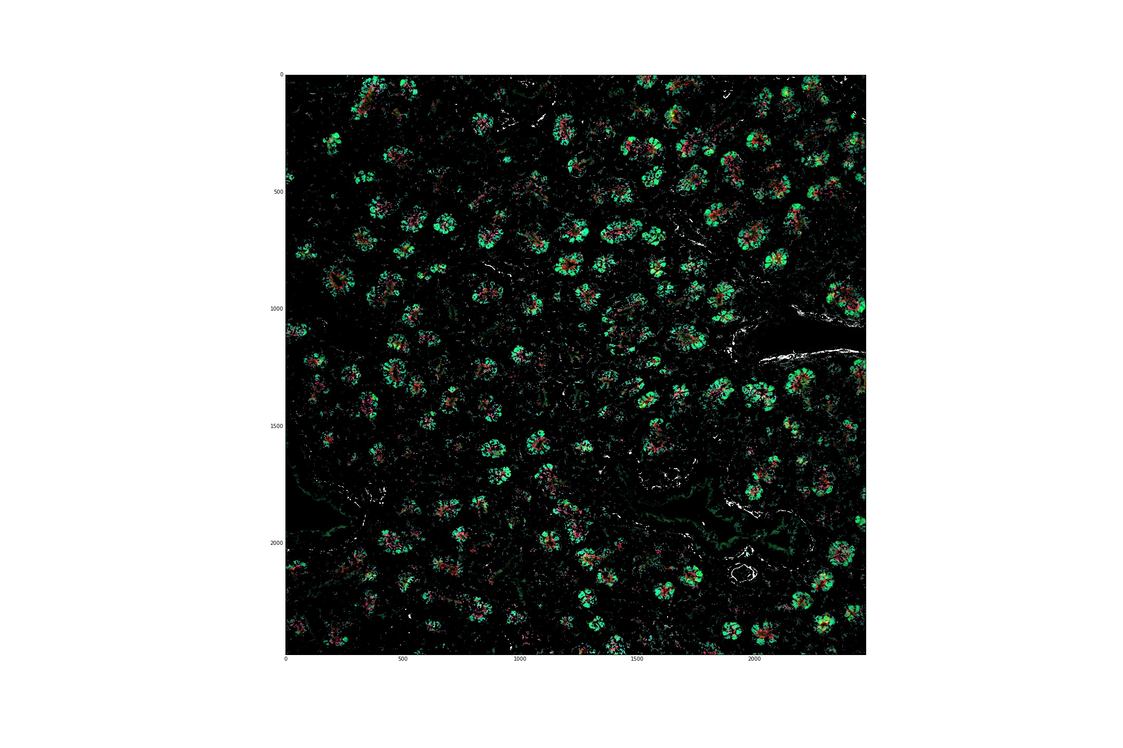
Progress
Notes:
Pablo

Slide 13
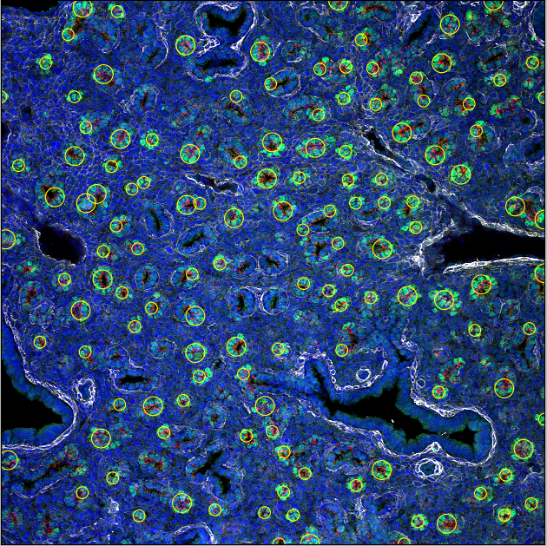
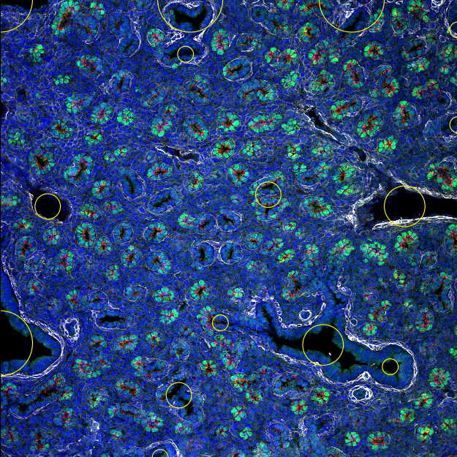
Progress Cont.
Notes:
Pablo

Slide 14
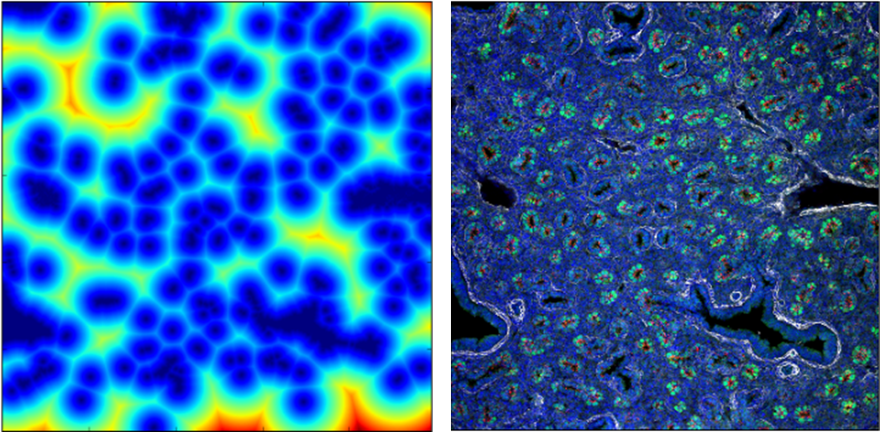
Progress Cont.
Distance Map
Notes:
Lina

Slide 15
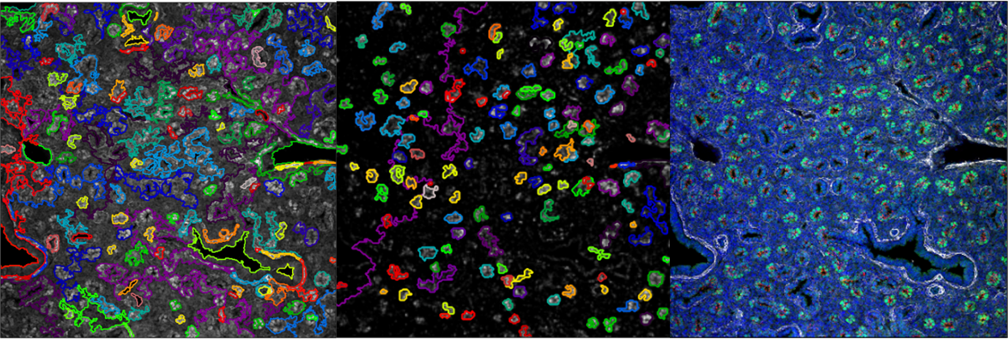
Progress Cont.
Hierarchical clustering
Notes:
Lina

Slide 16
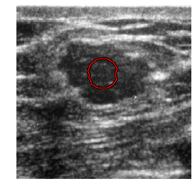
Future Work
Level set image segmentation
Cincinnati
Other ideas?
Notes:
Vivek

Slide 17
Citations
http://cdn.seoroadmap.org/wp-content/uploads/2014/11/seo-roadmap.jpg
http://www.lungmap.net
http://lambdaops.com/jupyter-environments-talk/pictures/jupyter-logo.png
https://upload.wikimedia.org/wikipedia/commons/thumb/5/55/FIJI_(software)_Logo.svg/2000px-FIJI_(software)_Logo.svg.png
http://scikit-image.org/_static/img/logo.png
http://www.healthcare-salaries.com/wp-content/uploads/2013/02/pulmonologist-salary.jpg
https://cdn.stepfeed.com/uploads/2015/11/13101526/20151113-healthy-lungs.jpg
http://hyperphysics.phy-astr.gsu.edu/hbase/fluids/imgflu/alveolicut.gif
http://matplotlib.org/_static/logo2.png
https://bids.berkeley.edu/sites/default/files/styles/400x225/public/projects/numpy_project_page.jpg?itok=flrdydei
http://people.duke.edu/~ccc14/lungmap-data-plus/Learning%20Resources.html#LungMAP

